Slide 1
Art by Geneva Tomolac

Slide 2
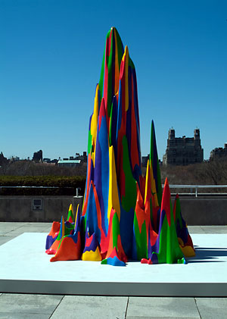
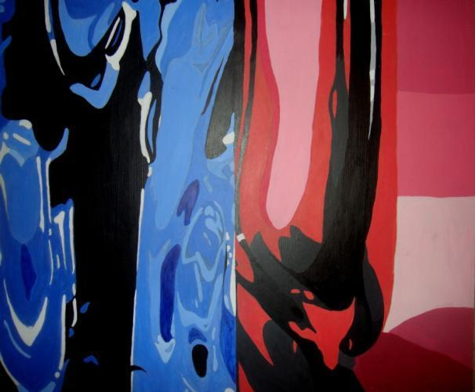
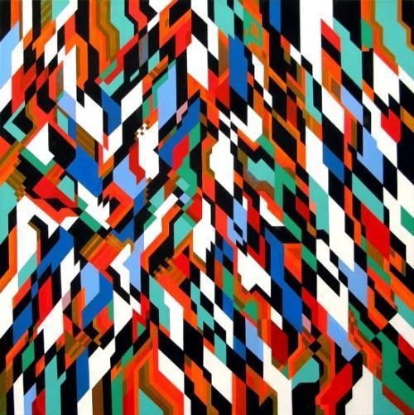
Crystal
From Here
Bridget Riley
Splotch 15
Sol LeWitt
Beyond the surface
Geneva Tomolac
1.8x1.4 feet
Acrylic on hard board
September 2011
What about now?
Sam Songailo

Slide 3
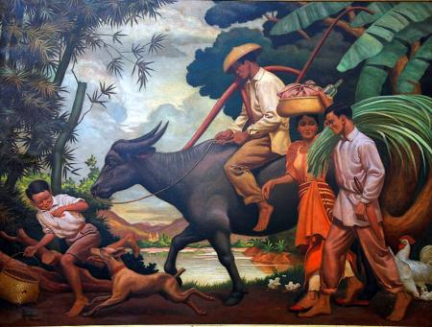
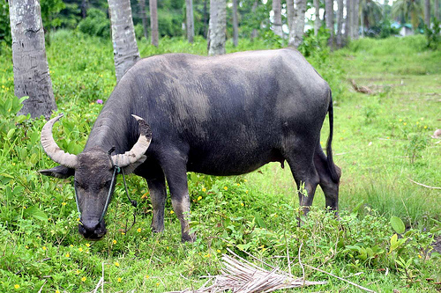
Sacred Vessel
Philippine’s flag
After the Day’s Toil
Vicente Alvarez Dizon
Water Buffalo or Carabao
Philippines
Filipino Buffalo
Geneva Tomolac
x
Acrylic paint on clay
December 2011

Slide 4
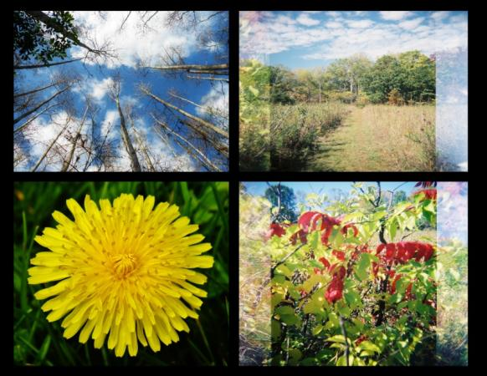
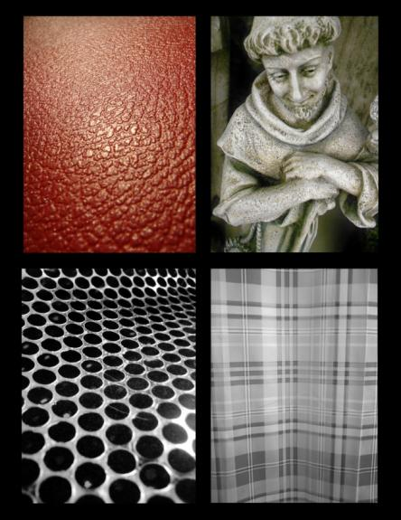
H o l g a

Slide 5
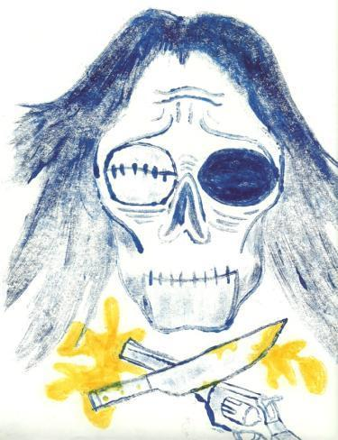
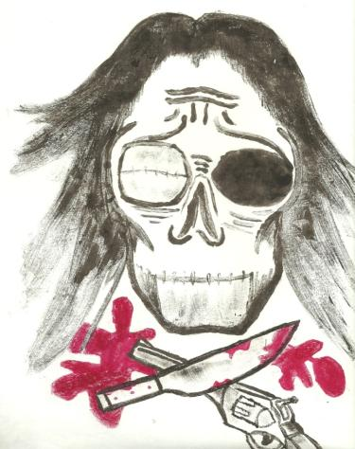
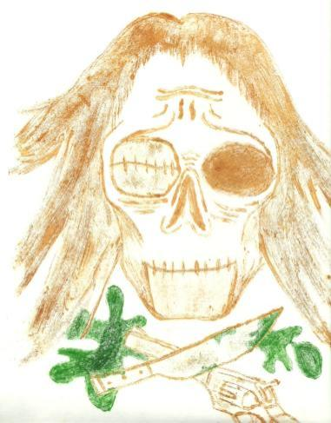
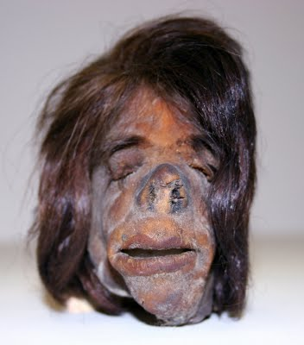
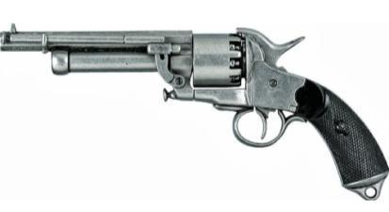
Monoprint
The Killer Inside Me
Geneva Tomolac
12x8 inches
Oil paint on paper
December 2011
Guns and Knives
-Common weapons for killing
Shrunken Head

Slide 6
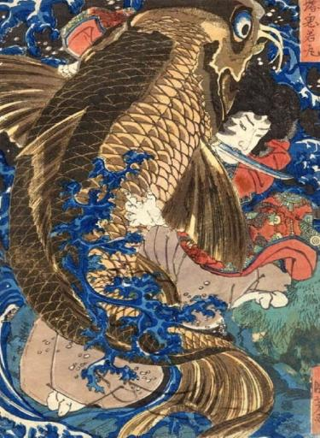
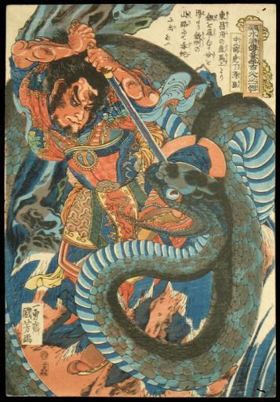
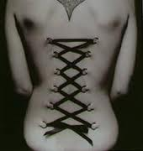
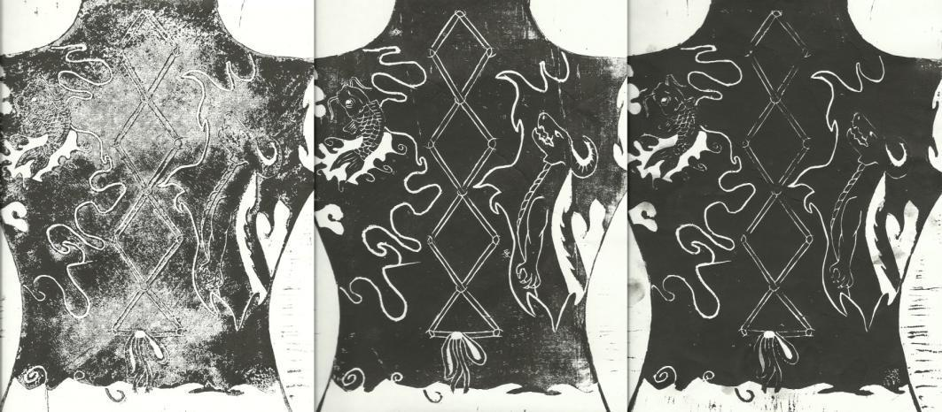
Blockprint
Saito Oniwaka Maru Benkei
Utagawa Kuniyoshi
Chūsenko Teitokuson, the arrow-wounded tiger
Utagawa Kuniyoshi
Corset Piercing
This is my art. What’s yours?
Geneva Tomolac
8x12 inches
Ink on paper
November 2011

Slide 7
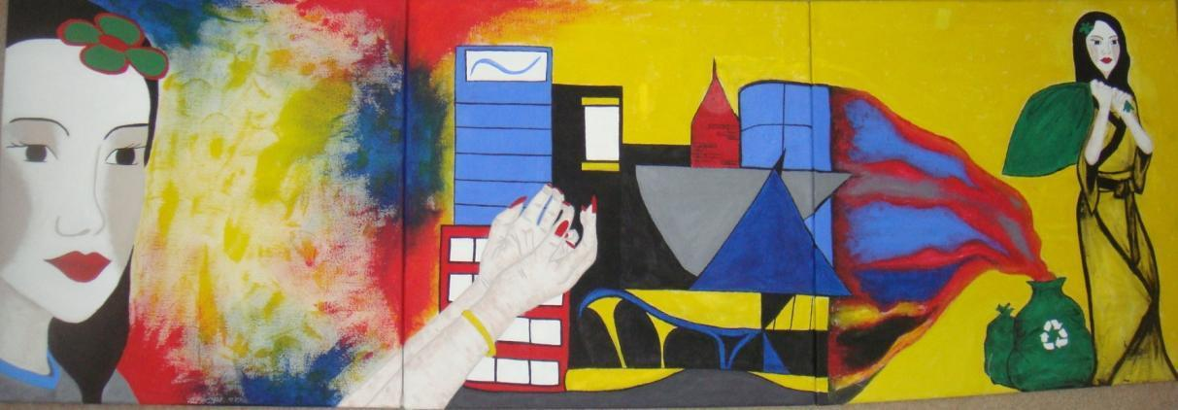
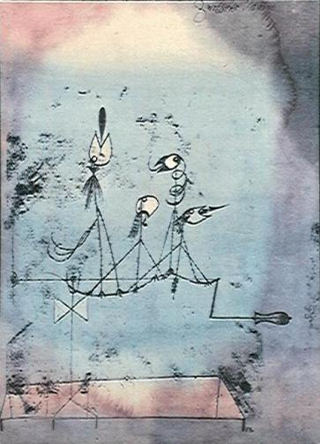
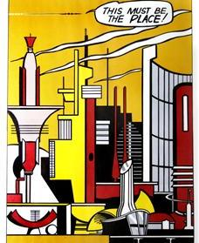
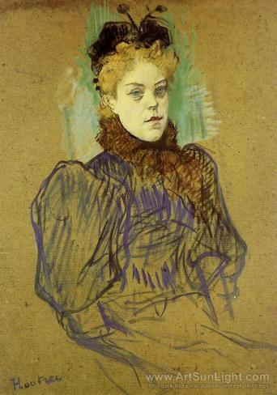
Tryptich
Her Journey
Geneva Tomolac
6x2 feet
Acrylic paint on canvas
November 2011
Twittering Machine
Paul Klee
This must be the place!
Roy Lichtenstein
May Milton 1895
Henri de Toulouse-Lautrec

Slide 8
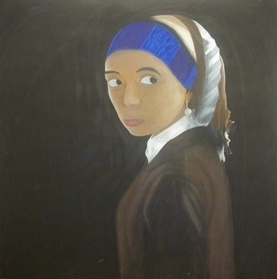
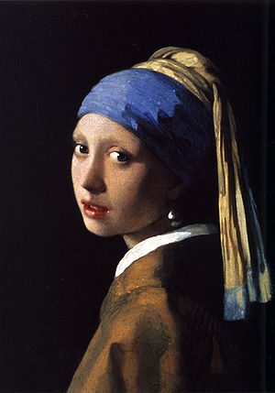
Portrait
Self Portrait
Geneva Tomolac
4x4 feet
Acrylic on canvas
February 2012
Girl with the Pearl Earring
Johannes Vermeer

Slide 9
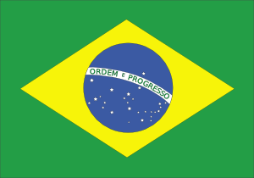
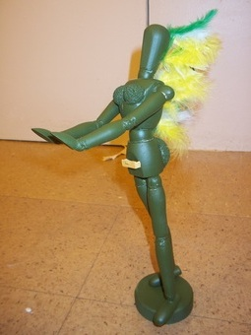
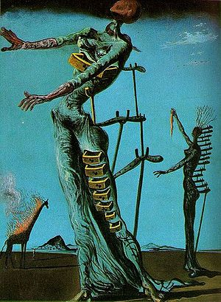
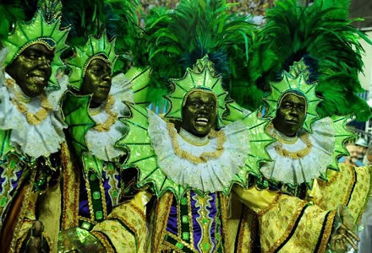
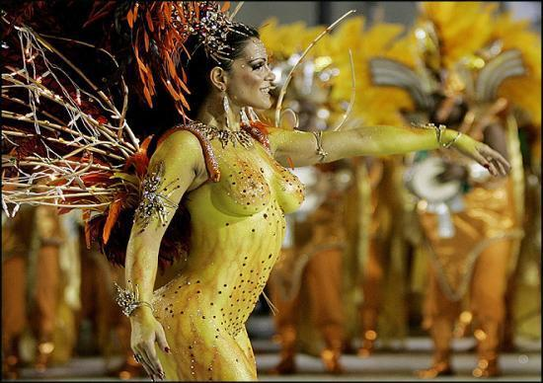
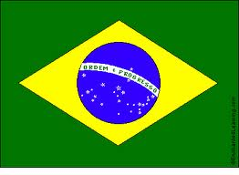
Found Object
Society’s Brazilian Beauty
Geneva Tomolac
12 inches (height)
Found Object
February 2012
Burning Giraffe
Salvador Dali
Carnival in Brazil
Brazil’s flag

Slide 10
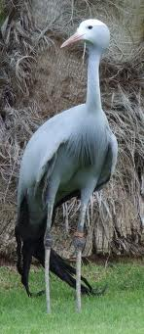
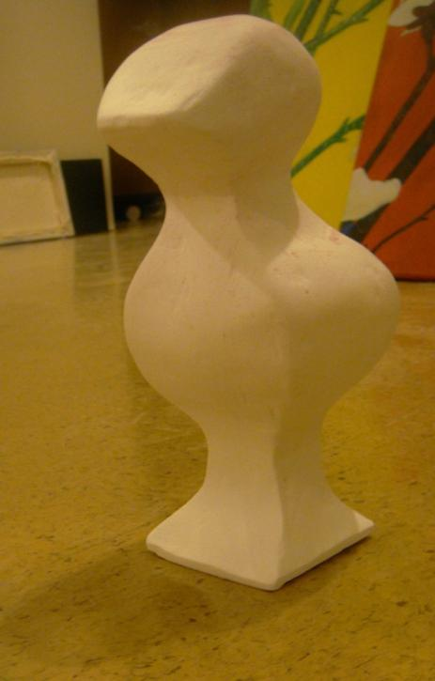
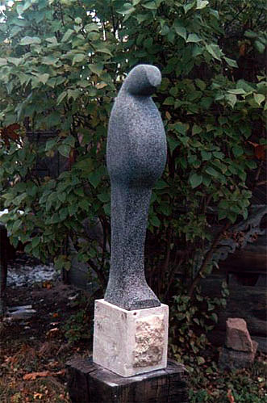
Abstract Sculpture
South African’s national bird – Blue Crane
Belly Bird
Dumitru Verdianu
The Independent Crane
Geneva Tomolac
x
Plaster sculpture
April 2012
South African flag

Slide 11
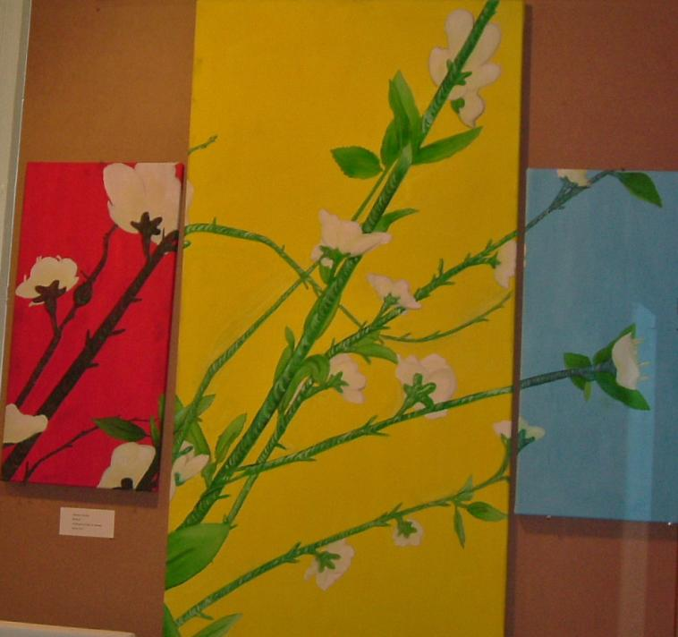
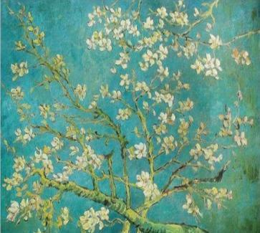
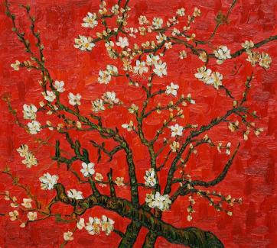
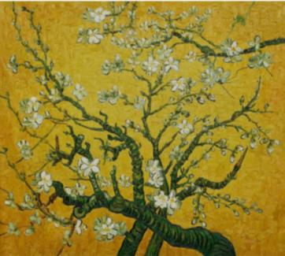
Painting based on Photography
Branches of an Almond Tree in Blossom
Vincent Van Gogh
Blossom
Geneva Tomolac
2x4 feet , 1x2 feet, 1x2 feet
Acrylic on canvas
April 2012

